Slide 1

EXPENSE REPORT APP

Slide 2
INTRODUCTION
AW Computing wants to retire their existing expense report systems, and they have tasked us with designing a simple expense reporting app.
Team members:
Divya
Rimma
Sravya
Quynh

Slide 3
THE PROBLEMS
1. Design a simple and user-friendly expense report app that meets all the specified requirements.
2. Ensure that users are only able to choose an Expense Report status of New or Complete.
3. Implement the necessary calculations to determine total expenses for Transportation, Accommodation and Food.

Slide 4
THE PROBLEMS
4. Automated submission to Managers and reassignment of expense reports to the Expense Processing Team.
5. Ensure that only the Expense Processing Team can delete and edit Expense Reports and Expense Items.
6. Provide Managers with access to their subordinates’ Expense Reports while maintaining data privacy and security.

Slide 5
DESIGN SOLUTION ADVANTAGES
1. Improved Security
2. Easy to Implement
3. Scalability
4. Improved User Experience
5. Compliance

Slide 6
DESIGN SOLUTION
1. Create an Expense Report app.
2. Create a custom object named “Expense Item” with a Master-detail relationship to the object “Expense Report”.
3. In Expense Report object, create 4 custom fields:
- Date Submitted
- Trip Purpose
- Report Status
- Department
Create a Validation Rule on Expense Report object to restrict the picklist values of the Report Status field to “New” or “Complete” only.

Slide 7
DESIGN SOLUTION
4. On Expense Item object, create these custom fields:
For Transportation:
- Transportation Type
+ Airline Company
+ Taxi Company
+ Rental Car Company
Set dependencies for Airline Company, Taxi Company, and Rental Car Company.
- Transportation Amount
- Transportation Comments

Slide 8
DESIGN SOLUTION
For Accommodation:
- Vendor
- Number of Nights
- Nightly Rate
- Accommodation Amount
- Accommodation Comments

Slide 9
DESIGN SOLUTION
For Food:
- Meal Type
- Food Amount
- Business Guest (must be included for all meals over $50)
Create a Validation Rule on Expense Item object to require Business Guest field when Food Amount is more than $50.

Slide 10
DESIGN SOLUTION
5. Create three formula fields on the “Expense Report” object to calculate Total Transportation Expenses, Total Accommodation Expenses, and Total Food Expenses.
6. Create a workflow rule that triggers when the “Report Status” field is changed to “Complete”. The workflow should update the “Report Status” field to “Submitted” and reassign ownership of the record to the record owner’s manger.
7. Create an approval process for the “Expense Report” object. The first approval step should be assigned to the record owner’s manager, and the second approval step should be assigned to the Processing Team.

Slide 11
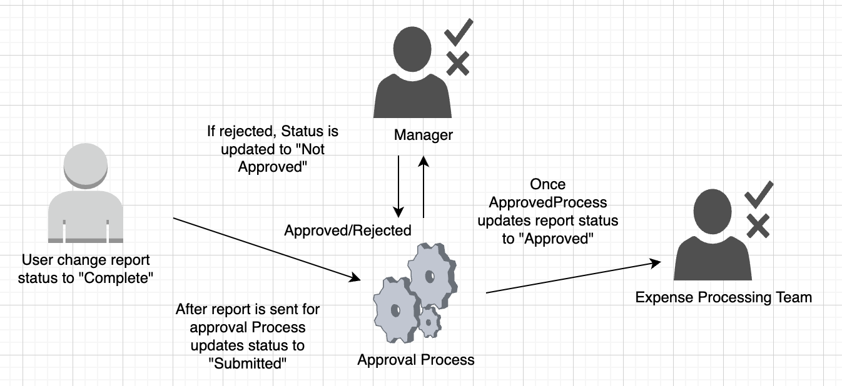
APPROVAL PROCESS DIAGRAM

Slide 12
DESIGN SOLUTION
8. Login as Manager to approve/reject expense report. Next it will go to other team members who are in Queue to approve the expense report.
9. Create Permission sets with delete access for expense team to provide security to the application. Assign that profile to the expense team. If you login as that user you can able to delete and edit record.
10. Create permissions for all users to create only.
11. Create Role Hierarchy so that Managers can able access their subordinate records.

Slide 13
Report Header
Date submitted Purpose of the trip | status of the report department of the expense
Line Items
Transportation | Accommodation
Type of transportation Amount Comments | Vendor Nights Number Rate Amount (calculated) Comments
An Expense Report consists of multiple line items

Slide 14
An Expense Report consists of multiple line items (continued)
Report Header
Date submitted Purpose of the trip Transportation Total Food Total | status of the report Department Accommodation Total
Line Items
Food
Meal Type (breakfast, lunch, dinner) Amount Business guest Comments

Slide 15
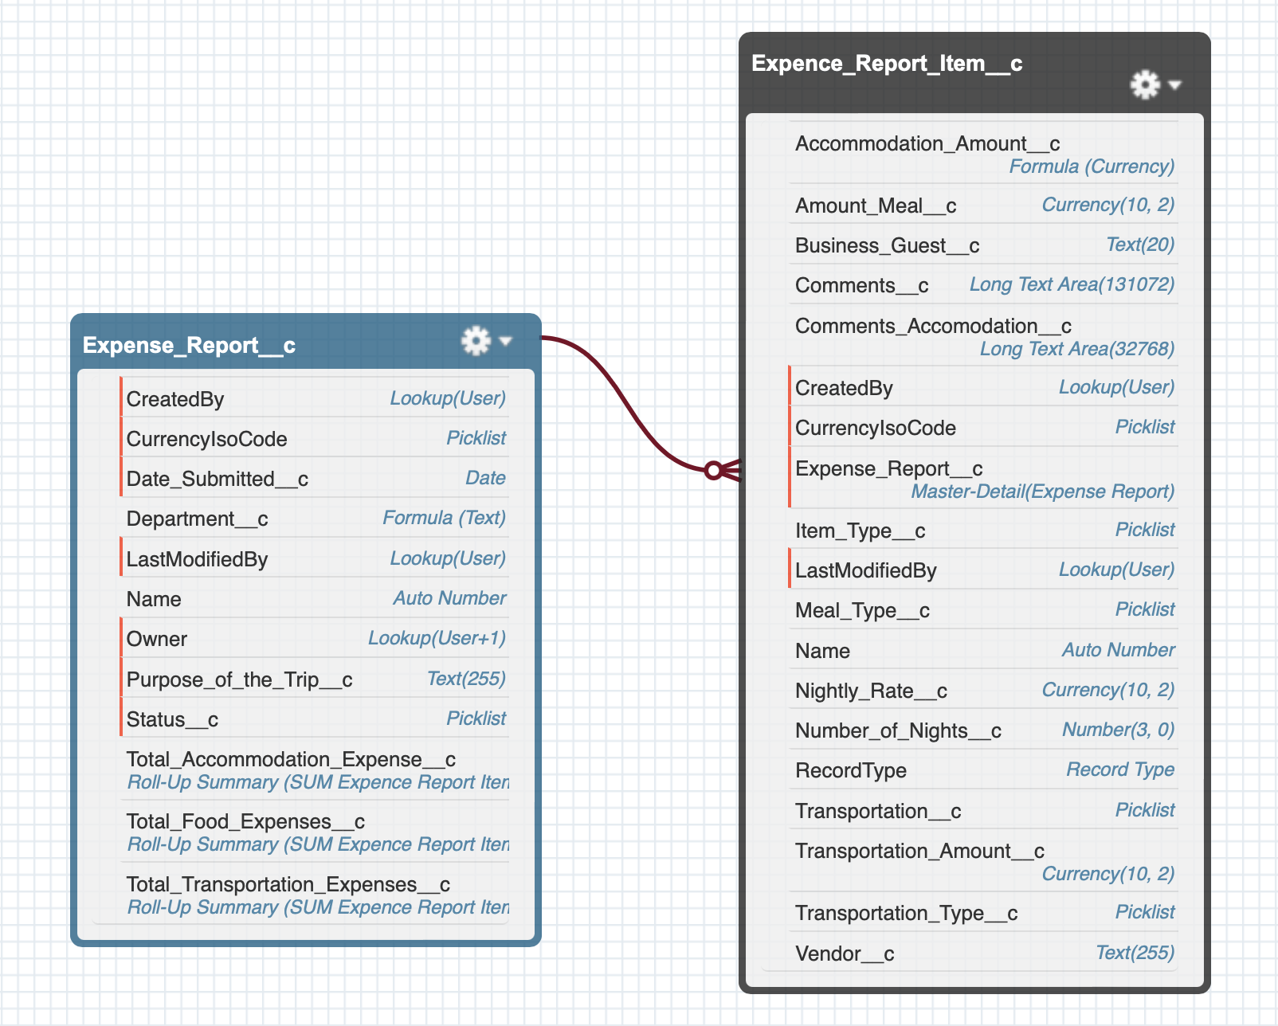
SALESFORCE OBJECTS
Expense report
Expense report items
Master – Detail relationship
Record Type for different expenses

Slide 16
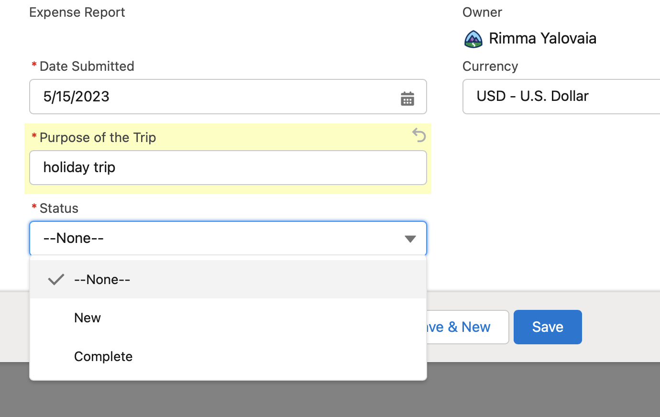
STATUS PICKLIST VALIDATION
User is only allowed to choose status New or Complete (Validation rule is set on the field).

Slide 17
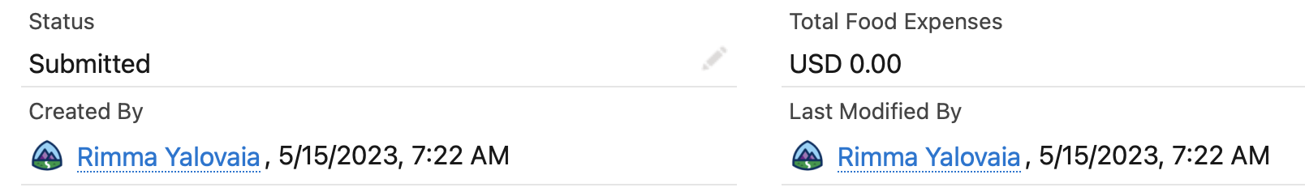
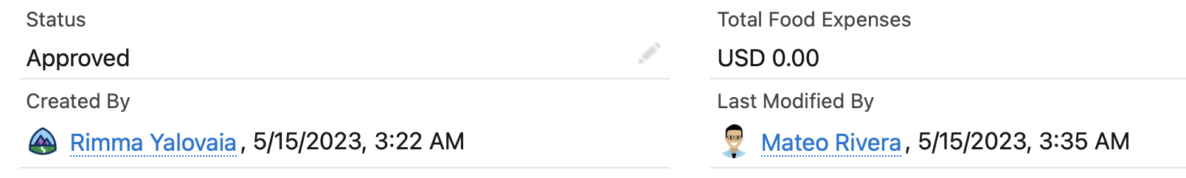
STATUS PICKLIST VALUE IS CHANGED AUTOMATICALLY
Once user changes status to Complete report is sent for approval to the manager and status is set to Submitted and Approved after the approval.

Slide 18
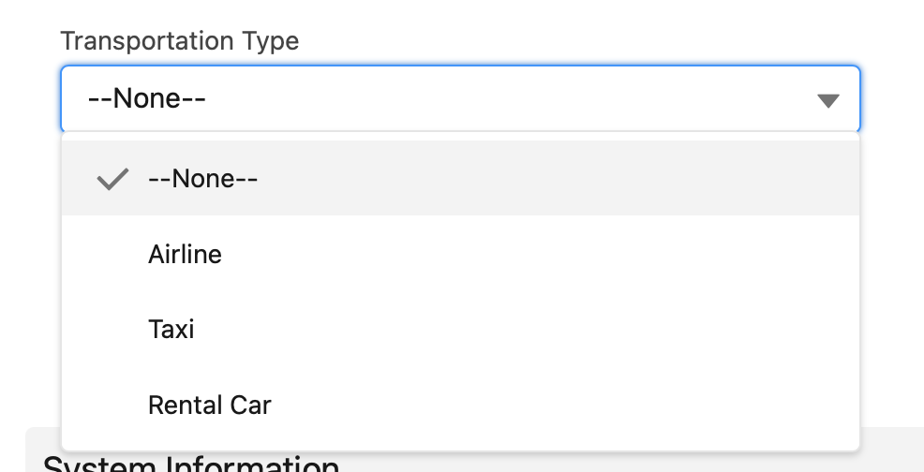
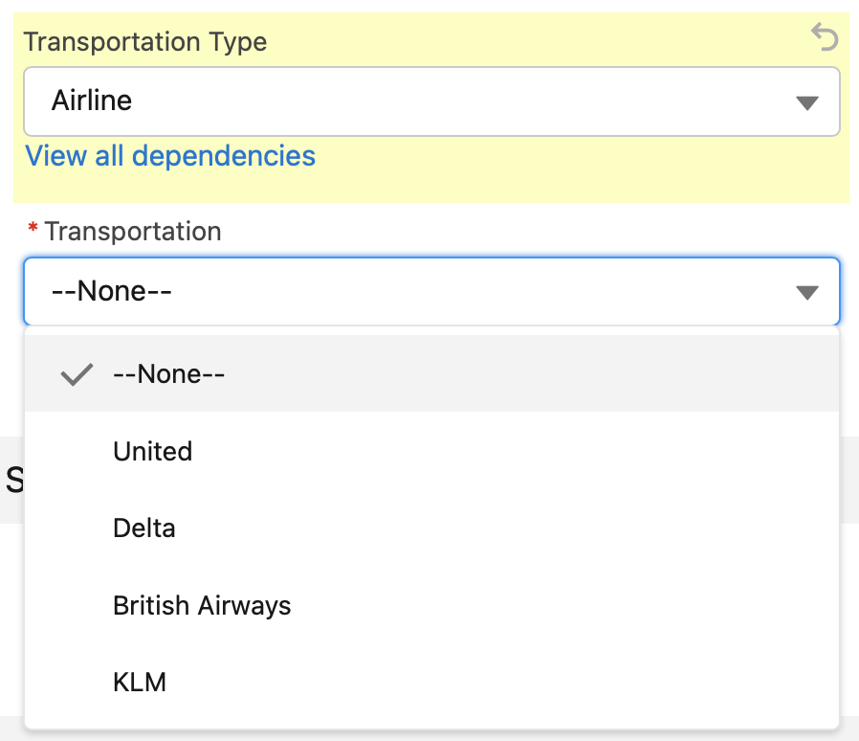
DEPENDENT PICKLISTS (Transportation type picklists consist of two levels)

Slide 19
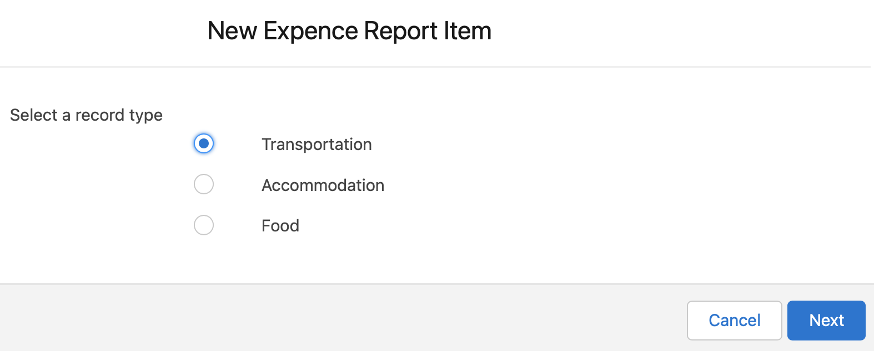
Each Expense Item should only show fields relevant to the type
This is achieved by record type and conditional formatting to hide non relevant fields.

Slide 20
DEPENDENT PICKLISTS (Transportation type picklists consist of two levels)

Slide 21
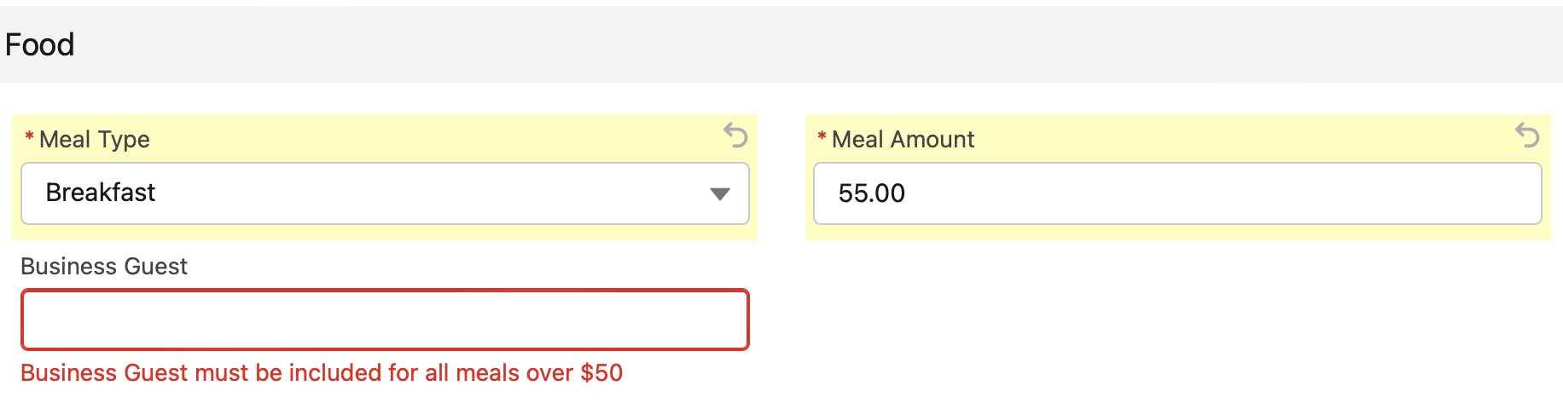
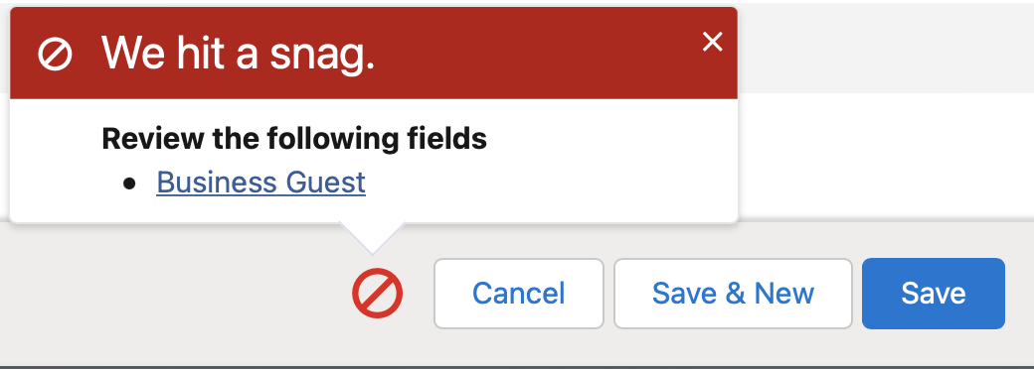
BUSINESS GUEST VALIDATION
Business guest must not be null for all meals over $50.

Slide 22
Use Roll Up Summary
- Total Transportation Expenses
- Total Accommodation Expenses
- Total Food Expenses
Use Roll-up Summaries
EXPENSE REPORT CALCULATIONS

Slide 23
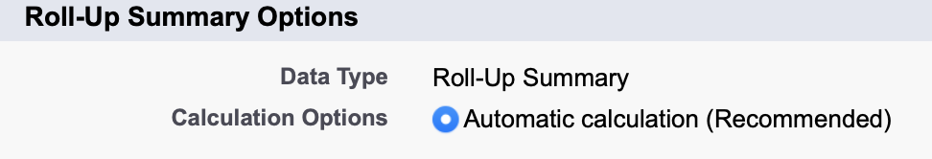
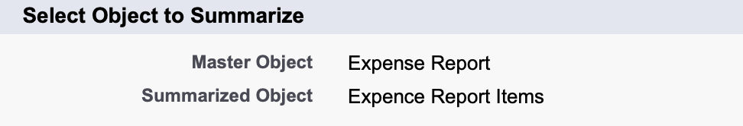
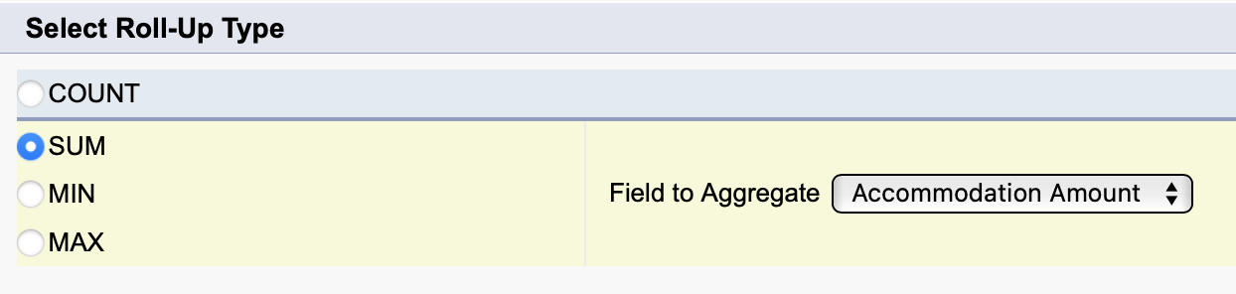
TOTAL CALCULATION FORMULA

Slide 24
APPROVAL PROCESS DIAGRAM

Slide 25
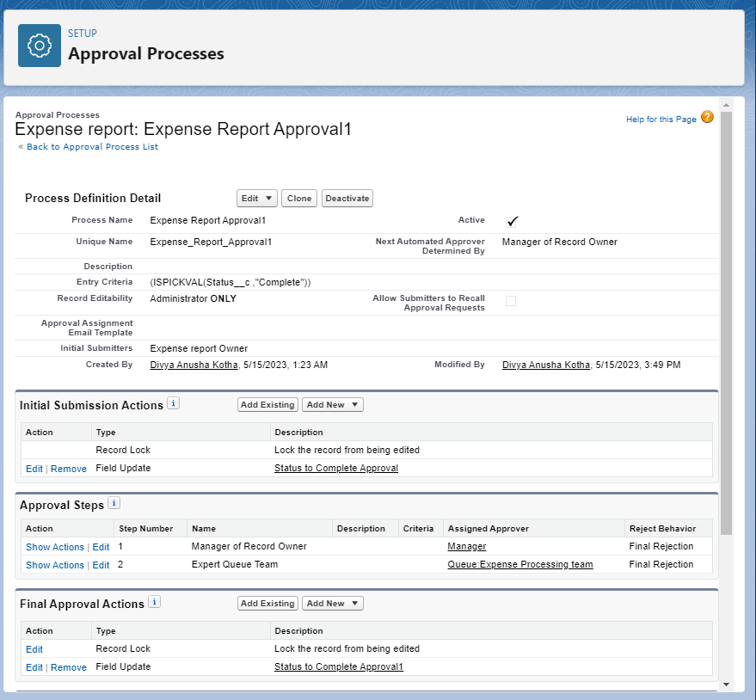
2-Step Approval Process
- Manager Approvals
- Expense Team
AN EXPENSE REPORT APPROVAL

Slide 26
QUEUE
Expert Queue Team:
Add desired members in that Queue: Jacob Lerner, Ted Kim, Maya Lorrette.
Add Queue to the 2-step Approval Process.

Slide 27
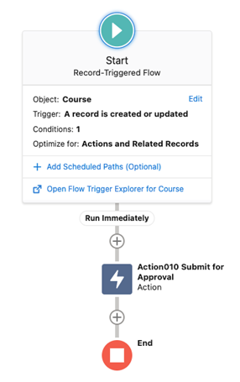
Flows
- Triggered-flow
- Action
AN EXPENSE REPORT APPROVAL
AUTOMATION

Slide 28
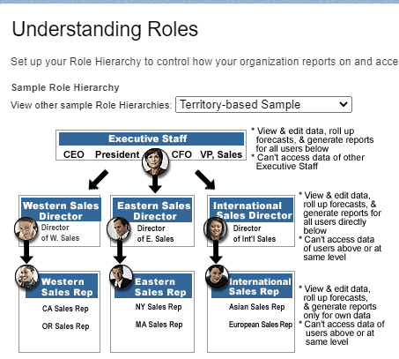
- Permission Sets
- Expense team allowed to delete Expense Reports
Team Able to edit the Expense Line Items
- OWD
- Role Hierarchy
DATA SECURITY

Slide 29
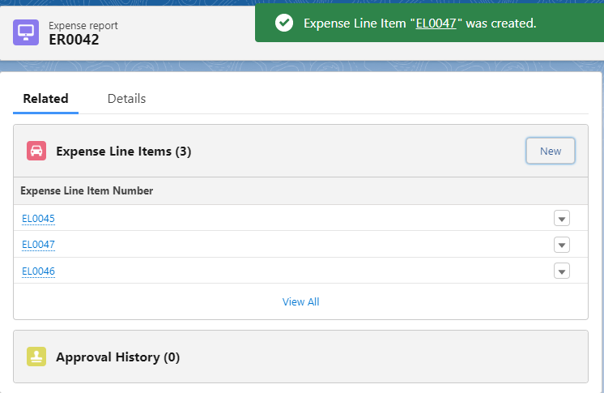
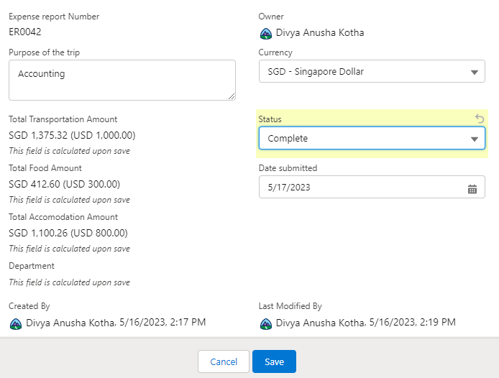
TIMELINE

Slide 30
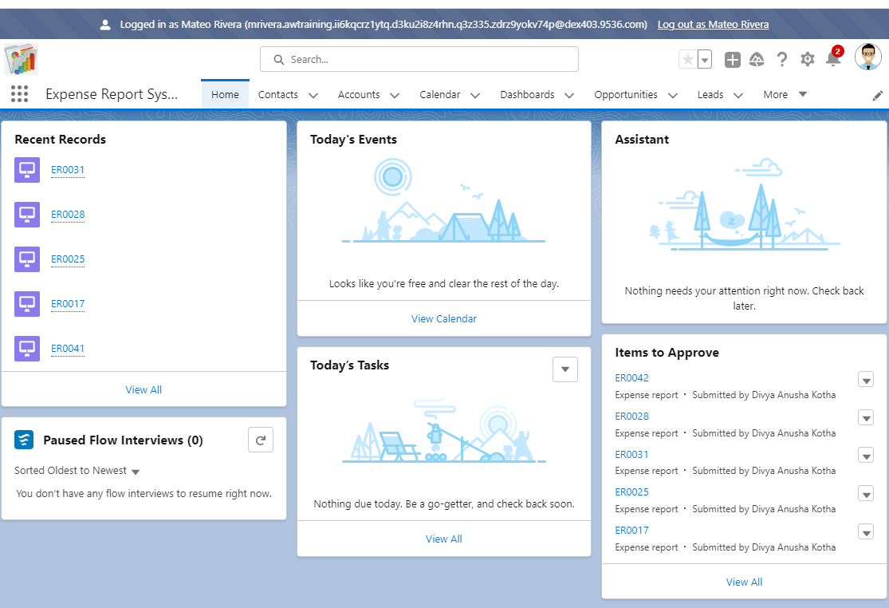
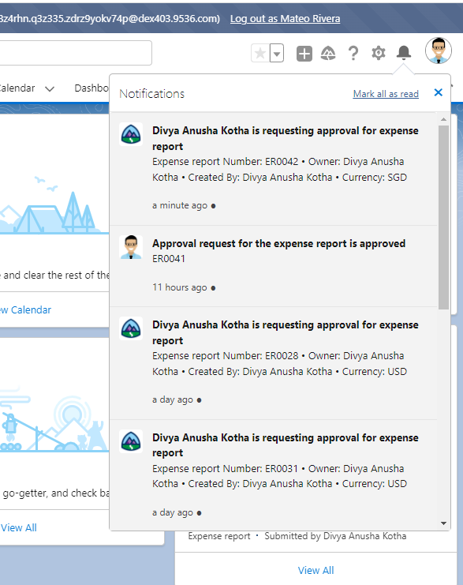
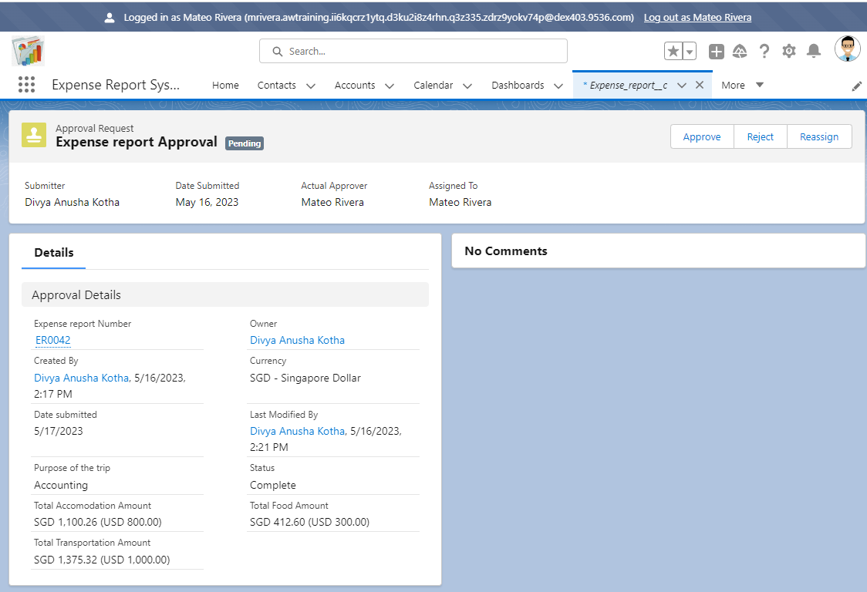
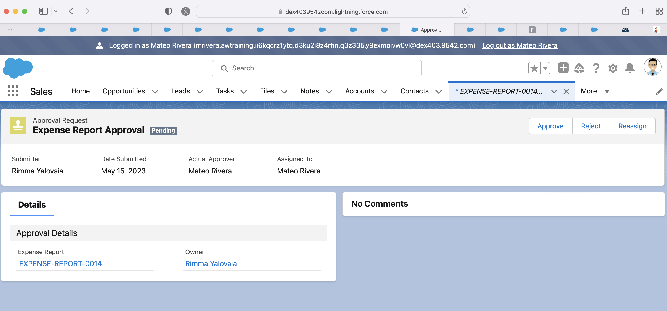

Slide 31
CALL – TO – ACTION
Rimma: rimmart@gmail.com
Ngoc Thuy Quynh Do: dntquynh@gmail.com
Sravya Komatineni: sravya.it24@gmail.com
Divya Anusha Kotha: divya.kotha03@gmail.com

